Slide 1
Digital portfolio
Student name: namitha.R
Register number: 2422k1586 And asbru4q2422k1586
College: ksg college of arts and science
University: bharathiar University

Slide 2
Agenda
1. Problem Statement 2. Project Overview 3. End Users 4. Tools & Technologies 5. Portfolio Design & Layout 6. Results & Screenshots 7. Features & Functionality 8. Conclusion 9. GitHub Link

Slide 3
Problem Statement
Clearly describe the issue your project solves.
A potential problem statement for a digital portfolio project could be: “How can we effectively showcase projects and skills in a digital portfolio to attract potential employers or clients, while ensuring ease of navigation and a visually appealing experience? “How can a digital portfolio be designed to clearly communicate a person’s expertise, creativity, and accomplishments, and stand out in a competitive online environment?” Would you like me to suggest more problem statements or help with your digital portfolio project?

Slide 4
Project Overview
.
A potential project overview for a digital portfolio could be: “Create a visually appealing and user-friendly digital portfolio that showcases my skills, projects, and accomplishments in [specific field or industry]. The portfolio will be designed to attract potential employers, clients, or collaborators, and demonstrate my expertise and creativity.” “Develop a digital portfolio that effectively communicates my personal brand, highlights my achievements, and provides a seamless user experience for visitors. The portfolio will feature a curated selection of projects, skills, and testimonials, and be optimized for various devices and platfor 1. Defining your target audience? 2. Identifying key features? 3. Choosing a platform or design?

Slide 5
End Users
1. *Potential employers*: Hiring managers, recruiters, or HR professionals looking for candidates with specific skills. 2. *Clients*: Businesses or individuals seeking freelancers or professionals with expertise in a particular area. 3. *Collaborators*: Other professionals, artists, or creatives interested in potential partnerships or projects. 4. *Industry peers*: Professionals in the same field, looking for inspiration, networking opportunities, or potential collaborat - Examples of work (projects, case studies, etc.) - Skills and expertise - Experience and achievements - Personal brand and style

Slide 6
Tools & Technologies
Languages, frameworks, software, or platforms used.
Here are some top tools and technologies for creating a digital portfolio - *Wix*: Offers drag-and-drop editor, customizable templates, and SEO optimization. It’s free, but has limitations on the free plan. - *Weebly*: Known for its drag-and-drop interface, customizable templates, and smooth blogging experience. - *Squarespace*: Provides sleek templates and user-friendly interface for creating professional-looking portfolios. - *Behance*: A popular platform for creatives to showcase their work, with features like customizable portfolios and job boards. - *Adobe Portfolio*: Offers simple yet effective templates, integration with Adobe ecosystem, and personalised URLs. - *Fabrik*: Designed for filmmakers and special effects artists, with features like lightboxes, sliding galleries, and film strips. - *Uxfolio*: A portfolio-building tool specifically designed for UX and UI designers, offering sleek templates and copywriting

Slide 7
Portfolio Design & Layout
1. *Clear navigation*: Make it easy for visitors to find what they’re looking for. 2. *Visual hierarchy*: Use size, color, and placement to draw attention to important content. 3. *Consistent branding*: Reflect your personal brand through typography, colors, and imagery. 4. *White space*: Balance content with negative space for a clean and professional look. 5. *Imagery*: Use high-quality images or screenshots to showcase your work. 1. *Grid-based*: Organize content into a grid for a clean and structured look. 2. *Masonry-style*: Use a Pinterest-like layout for a more dynamic and visual display. 3. *Single-page*: Showcase all your work on a single page, with sections and scrolling. 4. *Project-based*: Dedicate a page or section to each project, with detailed information. 1. *Choose a limited color palette*: Reflect your brand and keep the design cohesive. 2. *Use typography effectively*: Select fonts that are readable and consistent with your brand. 3. *Add interactive elements*: Use animations, scrolling effects, or hover effects to enhance user experience. 4. *Optimize for mobile*: Ensure your portfolio looks great on various devices and scre

Slide 8
Features & Functionality
1. *Project showcase*: A way to display your projects, with images, videos, or other media. 2. *Project details*: Include descriptions, technologies used, and accomplishments for each project. 3. *Navigation*: Easy-to-use menus, filters, or categories to help visitors find specific content. 4. *Contact information*: A way for visitors to get in touch with you, such as a contact form or email a 1. *Blog or articles*: A section for sharing your thoughts, experiences, or expertise. 2. *Case studies*: In-depth examinations of specific projects or challenges. 3. *Testimonials*: Quotes or reviews from clients, colleagues, or mentors. 4. *Skills and expertise*: A way to showcase your technical skills, certifications, or areas of expertise. 5. *Responsive design*: Ensure your portfolio looks great on various devices and screen sizes. 1. *Easy updates*: Allow for simple addition, editing, or removal of content. 2. *Customization*: Options for personalizing the design, layout, and content. 3. *Search engine optimization (SEO)*: Optimize your portfolio for search engines to improve visibility. 4. *Analytics*: Track visitor behavior, engagement, or other metrics to refine your portfolio. 5. *Integration with social media*: Link to your social media profiles or embed f

Slide 9
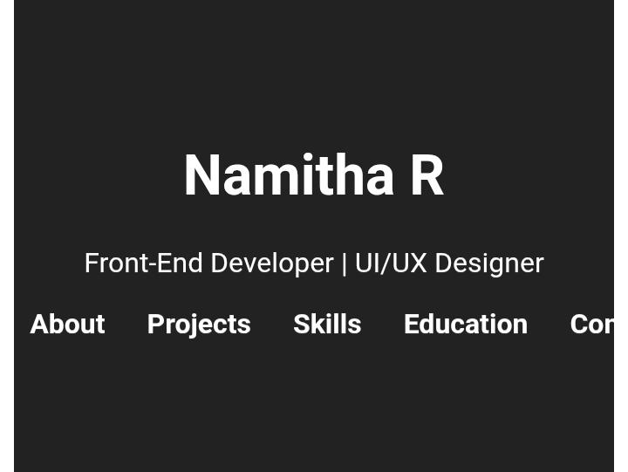
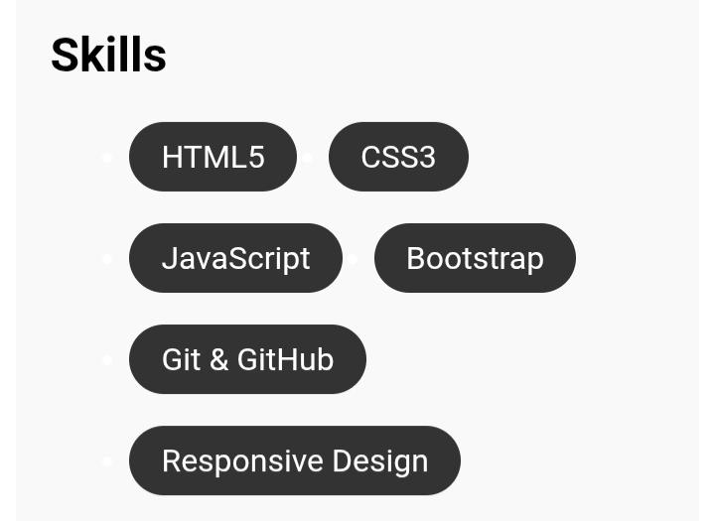
Results & Screenshots

Slide 10
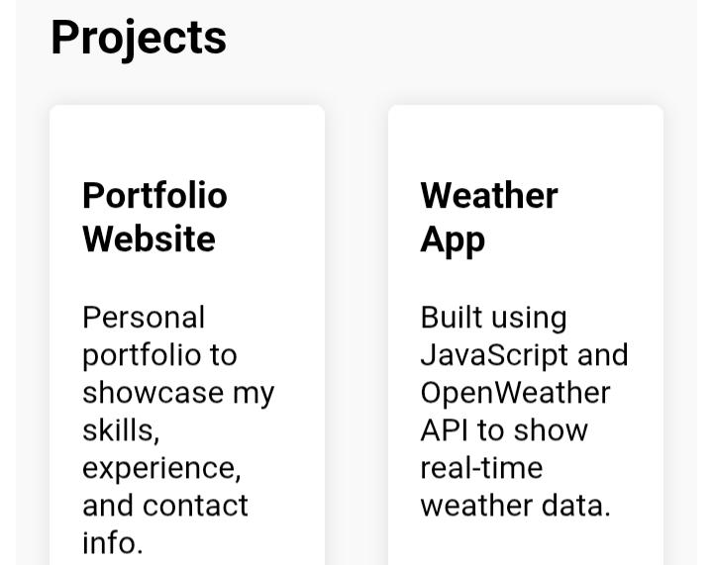
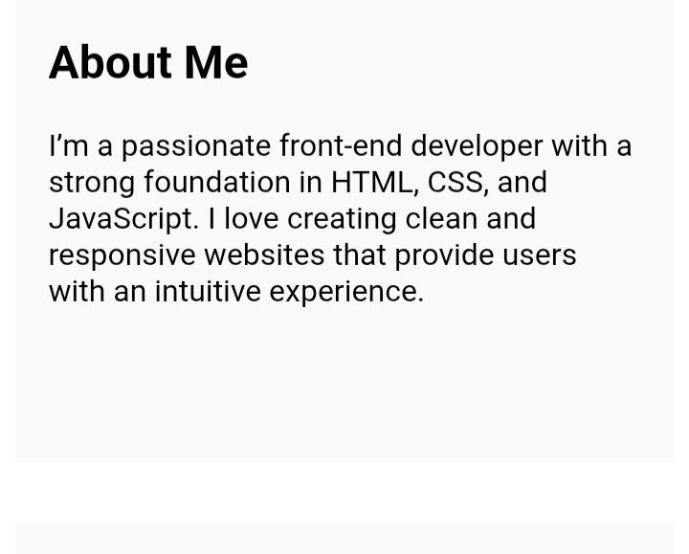
Screenshots

Slide 11
Conclusion
Future scope (optionalA digital portfolio effectively showcases your work, skills, and experience, enhancing your professional online presence and attracting opportunities. It’s a valuable tool for career advancement and personal branding.).

